Slide 1
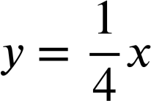
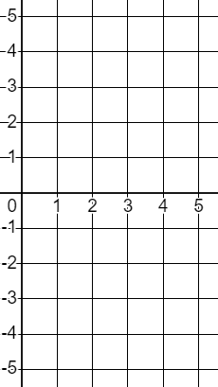
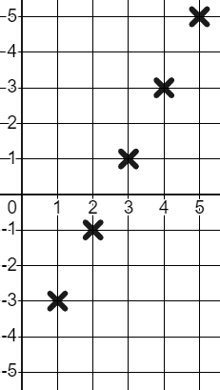
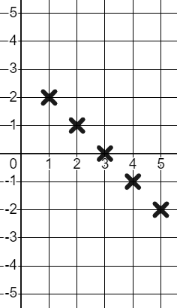
Features of linear relationships
Task A: The constant rate of change
1) Classify these relationships into linear and non-linear.
Linear
Non-linear
y = 4x
y = x + 4
y = 4x²
y⁴ = x + 4
4y = x
x + y = 4
y = 2x⁴
y = x⁴ + 4
y = 0.4x
y = x^{0.4}
Exponent of 1
Exponents not 1
2) Complete the table for the given range of x values. Plot the relationships and show on the graph their constant rate of change.
a)
y = 2x − 5
x | 1 | 2 | 3 | 4 | 5
y | −3 | −1 | 1 | 3 | 5
y
+2
+1
+2
Because of the constant rate of change this is a linear relationship.
+1
x
+2
+1
b)
+2
+1
y = 3 − x
y
x | 1 | 2 | 3 | 4 | 5
y | 2 | 1 | 0 | −1 | −2
+1
−1
Because of the constant rate of change this is a linear relationship.
x

Slide 2
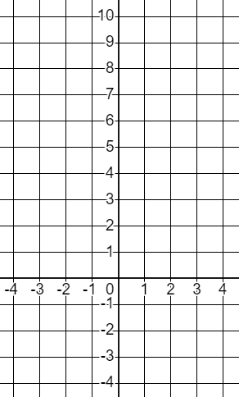
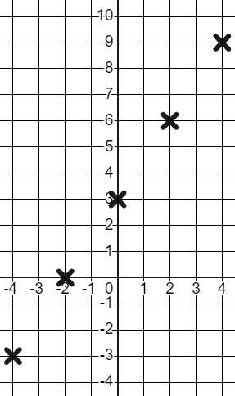
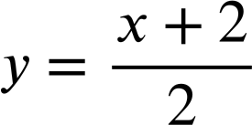
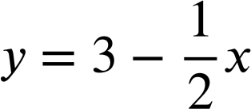
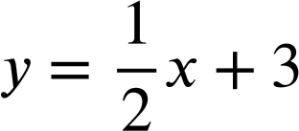
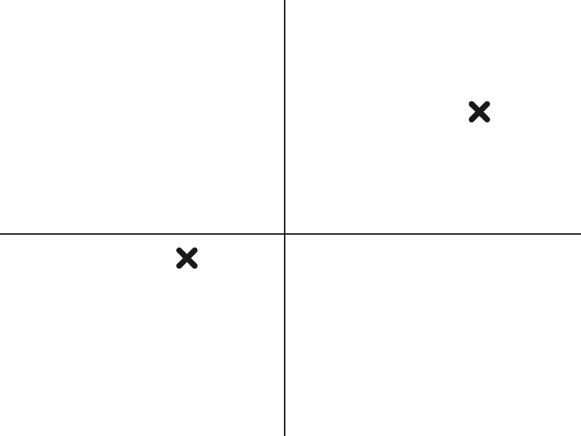
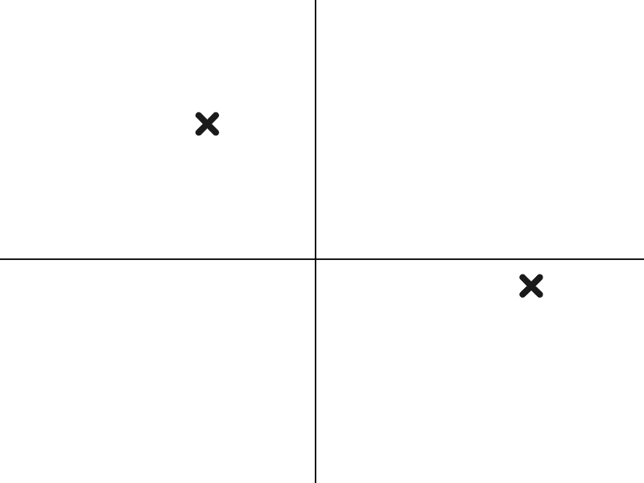
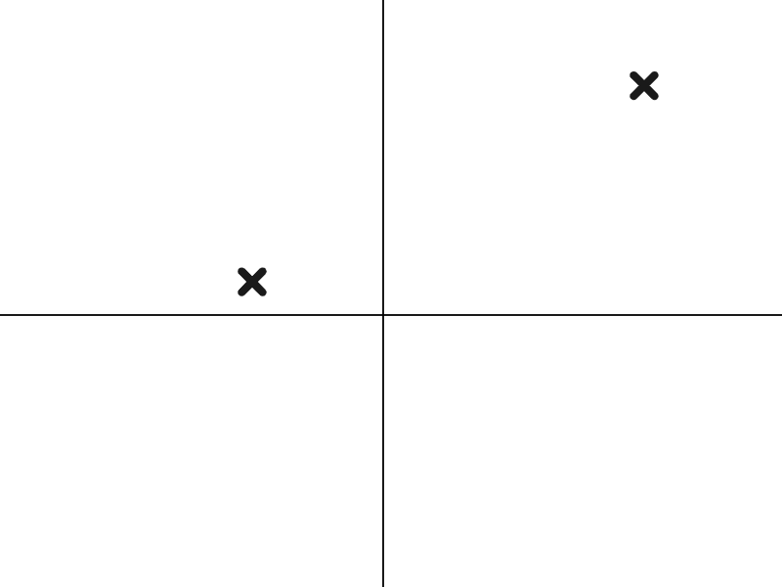
Features of linear relationships
3) This set of coordinates has a linear relationship with a constant rate of change.
Find the missing values, plot the graph, and show the constant rate of change.
y
+2
+3
x | −4 | −2 | 0 | 2 | 4
y | −3 | 0 | 3 | 6 | 9
+2
+3
+2
+3
x
Constant rate of change makes a linear relationship.
+2
+3
Task B: Graphical and algebraic representations
1) Match the coordinate pairs to their respective relationships and graphs.
F
D
E
C (−4,−1) and (8, 5)
B (−4, 5) and (8,−1)
A (−4, 1) and (8, 7)
G
H
I
Matching coordinates to quadrants is a good place to start.
Mathematics in Education and Industry
v2.2

